Slide 1








DATA ANALYTICS ON WEATHER MONITORING STATION
By
K. Jaya Srikanth (150030389)
K. V. V. Abhinov Kumar (150030390)
M. H. K. Surya Prasad (150030584)
Guide: K. Sripath Roy

Slide 2
Objectives:
Applying data analytics on NSS data.
To develop an IOT based Weather Monitoring Station.
Storing and retrieving the data from MQTT server using Python and MySQL.
Data Visualization using Thingsboard.
Using machine learning, predicting the future weather.

Slide 3
Flow Chart:
IOT
Data Analysis
NSS Data
Pre-Processing
Retreiving Data
From ThingdBoard
Interfacing
ThingsBoard
Data Visualization
Predicting Future
Building Model
Data Cleaning

Slide 4
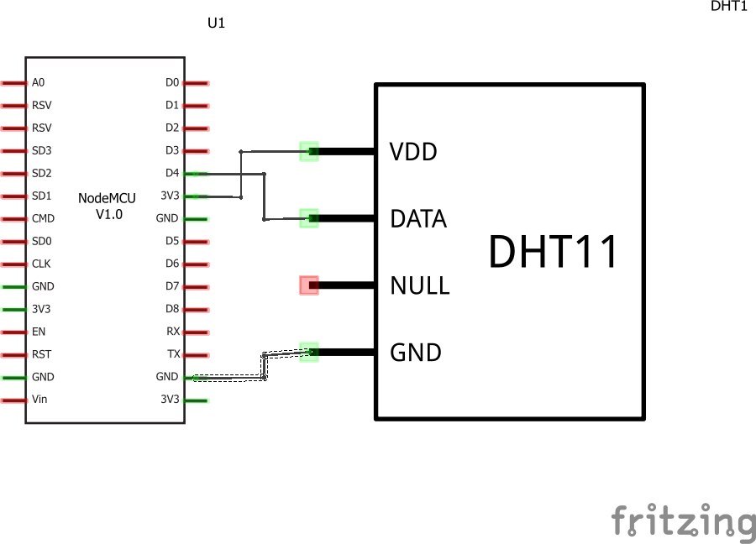
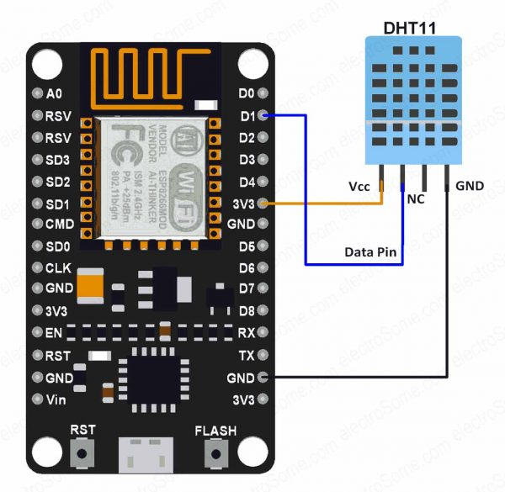
Block Diagram:

Slide 5
Tech stack:
NodeMCU
DHT11
MQTT Protocol
Thingsboard
Sypder 3.0 IDLE
Anaconda
Jupyter Notebook
Machine Learning Libraries(matpoltlib,pandas,NumPy,Scikit-Learn,Metrics).

Slide 6
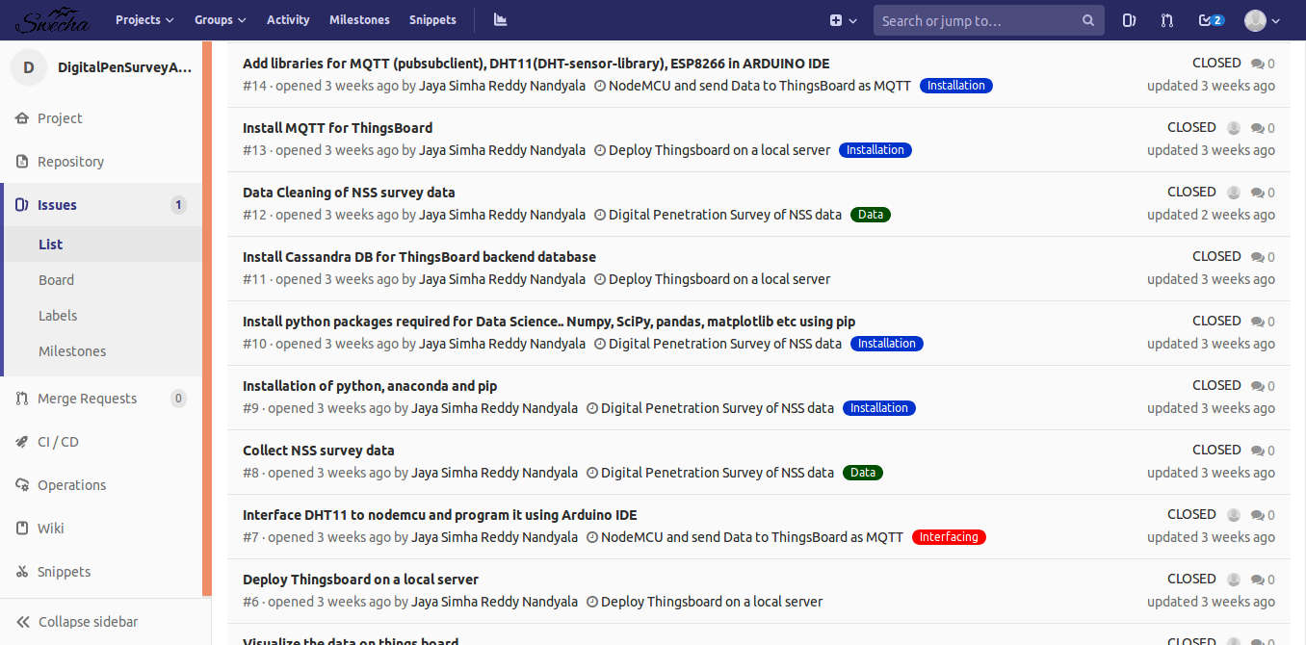
Scrum and Sprints:

Slide 7
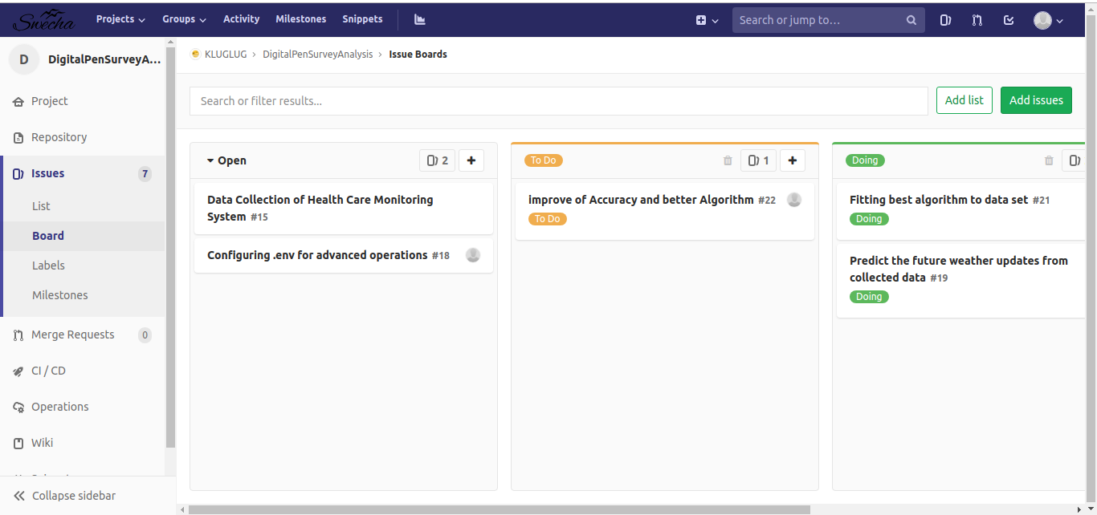
Task board

Slide 8
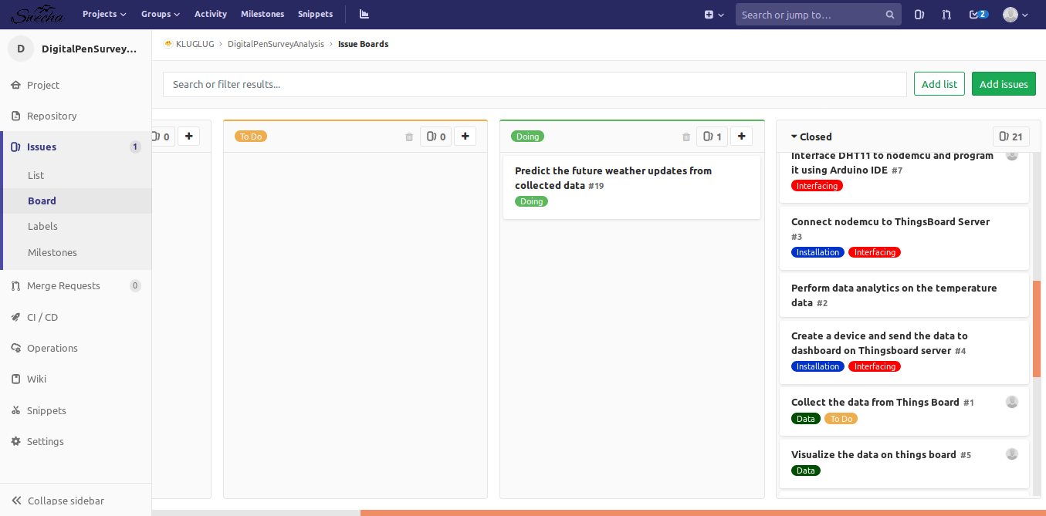
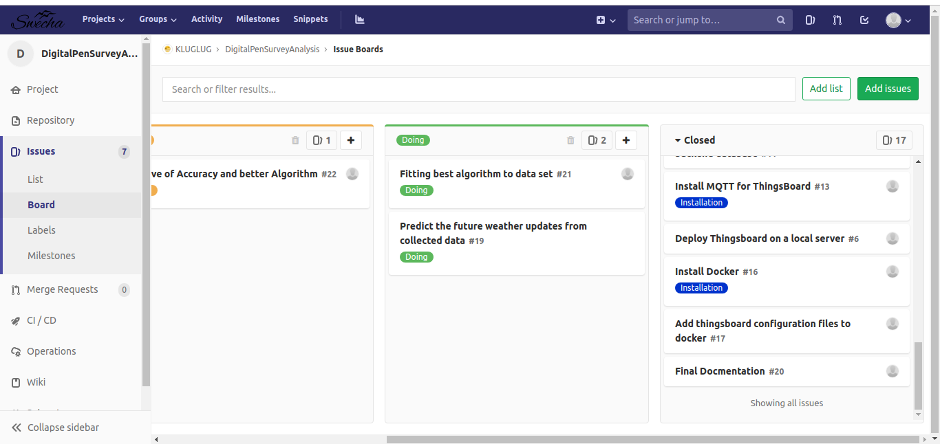

Slide 9
Digital Penetration Survey Analysis
Collection of Data from NSS cell.
Data Visualization using Python Packages.
Generating patterns out of the data.

Slide 10
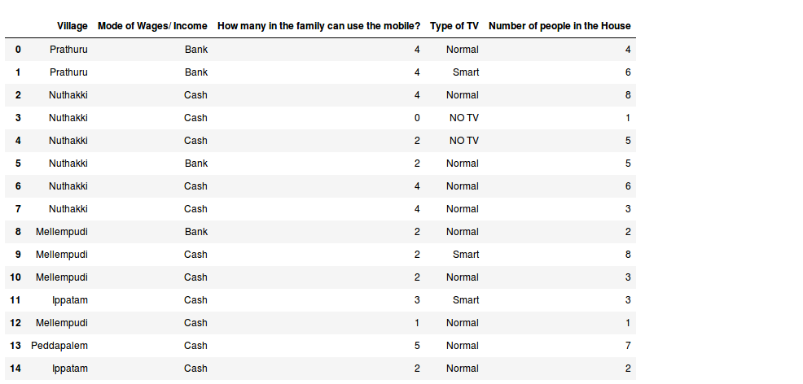
Sample Dataset

Slide 11
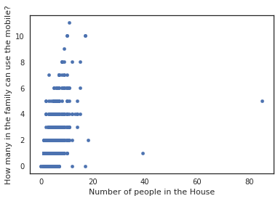
Scatter plot of NSS data

Slide 12
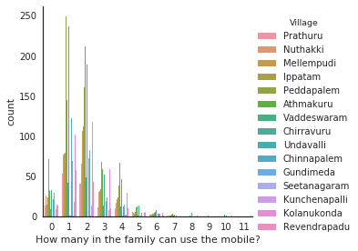
Data Analysis

Slide 13
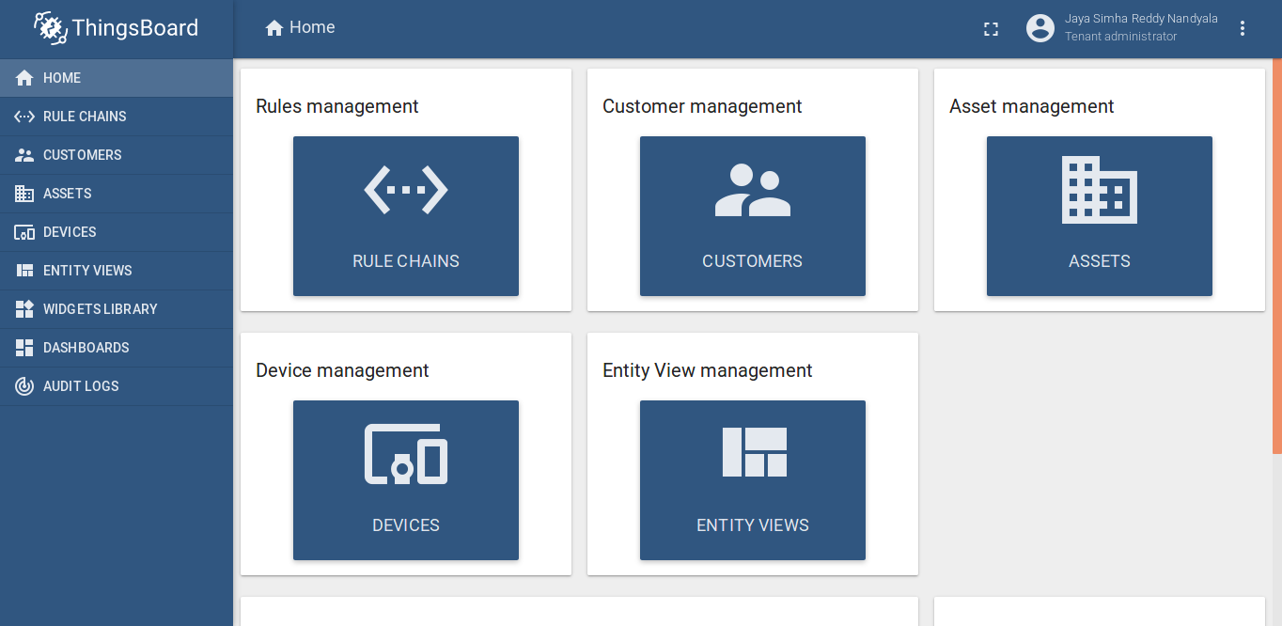
Thingsboard

Slide 14
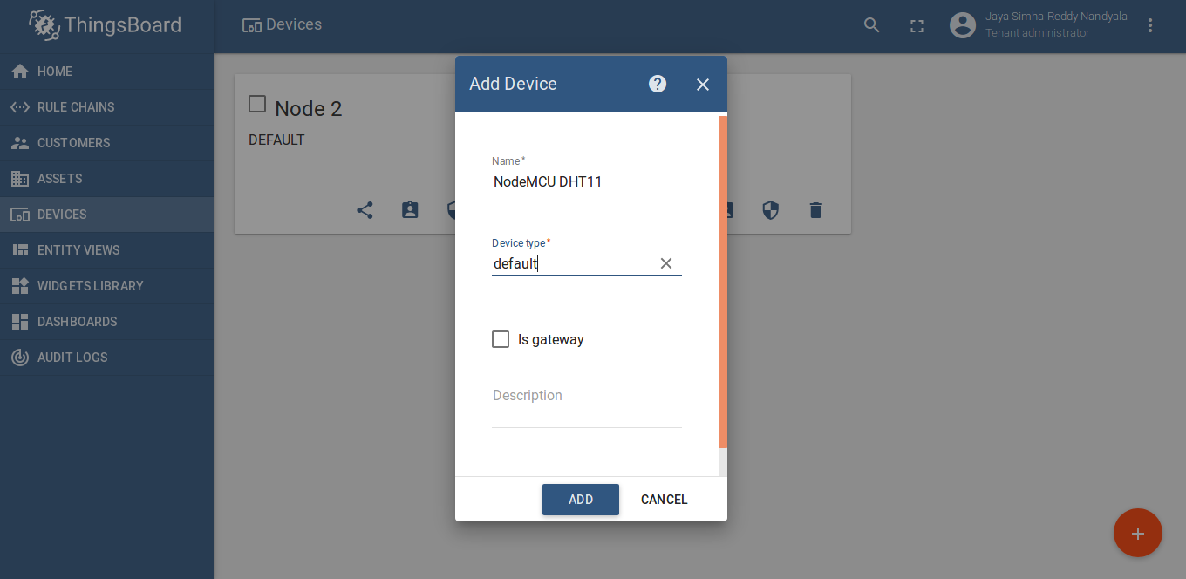
Create a new Device

Slide 15
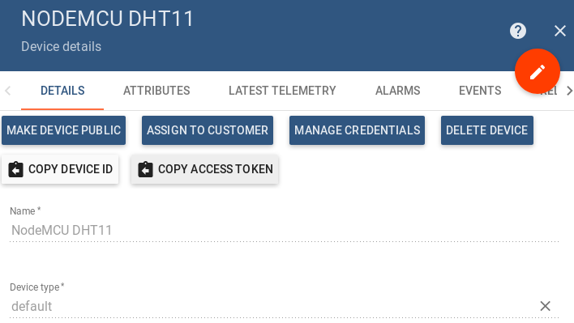
Copy Access Token

Slide 16
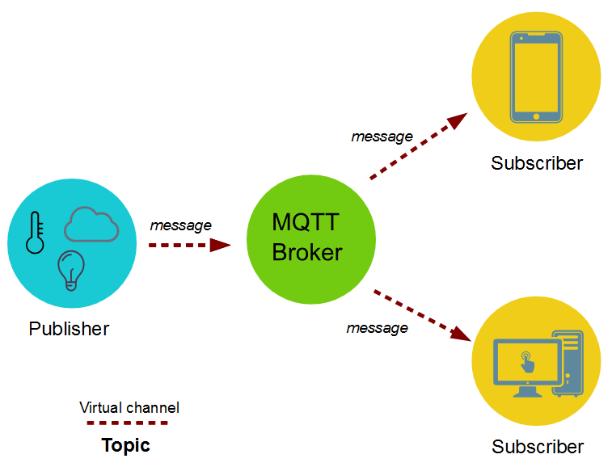
MQTT Protocol

Slide 17
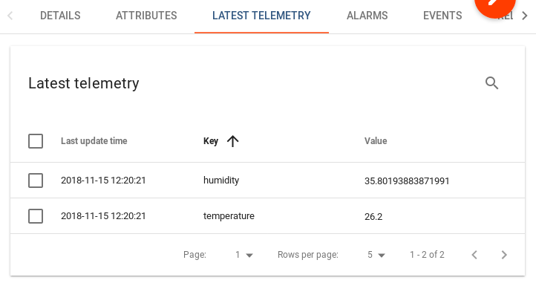
Getting Live data from NodeMCU

Slide 18
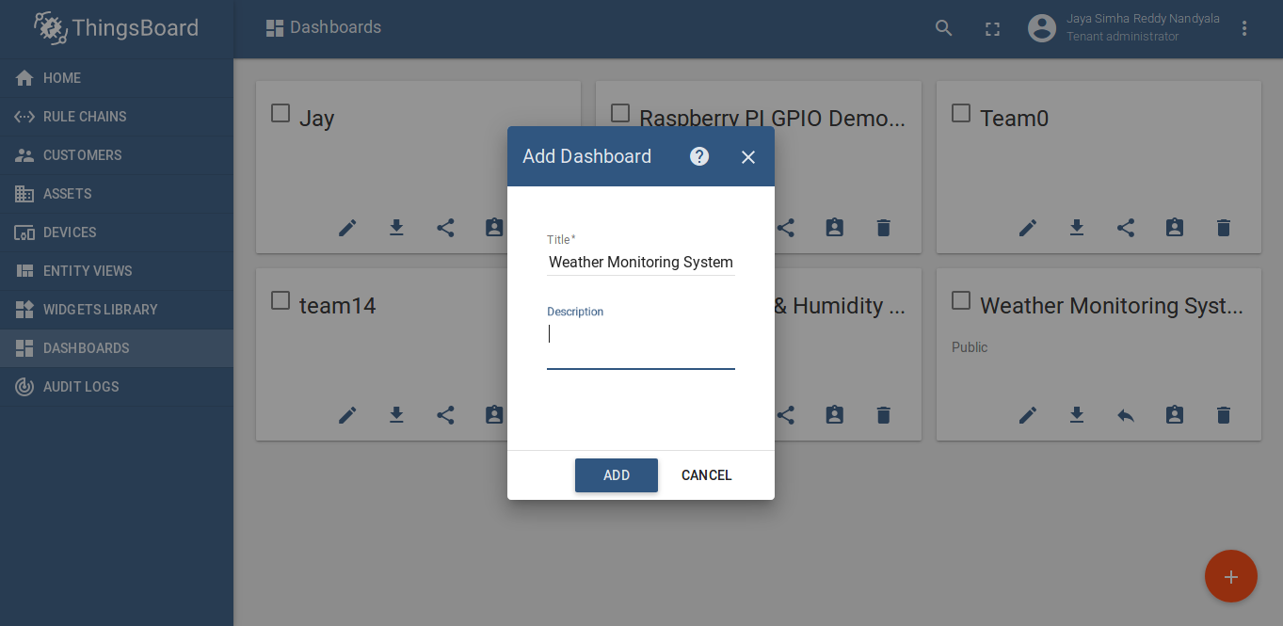
Create a new Dashboard

Slide 19
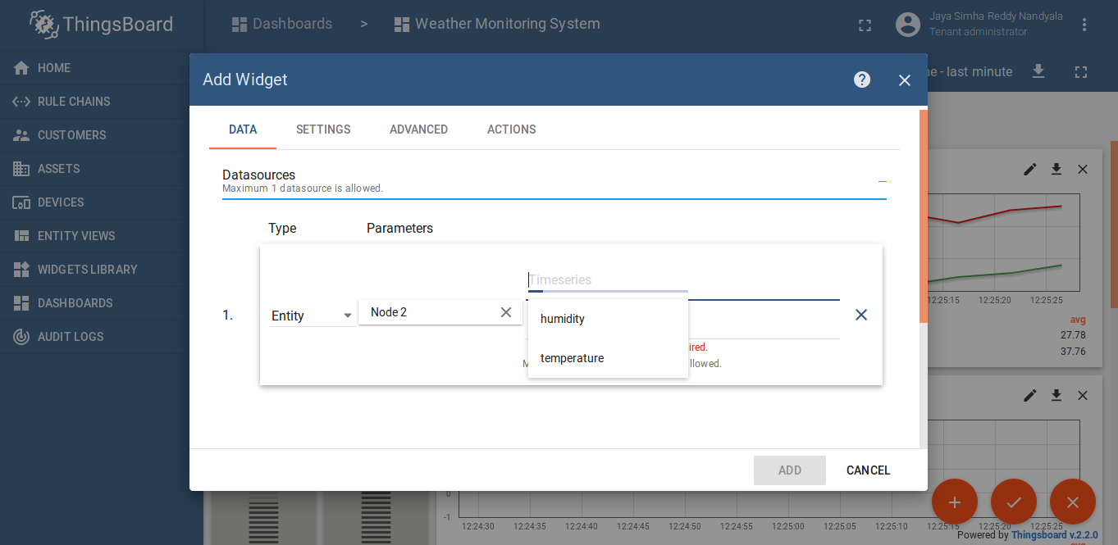
Adding widgets into dashboard

Slide 20
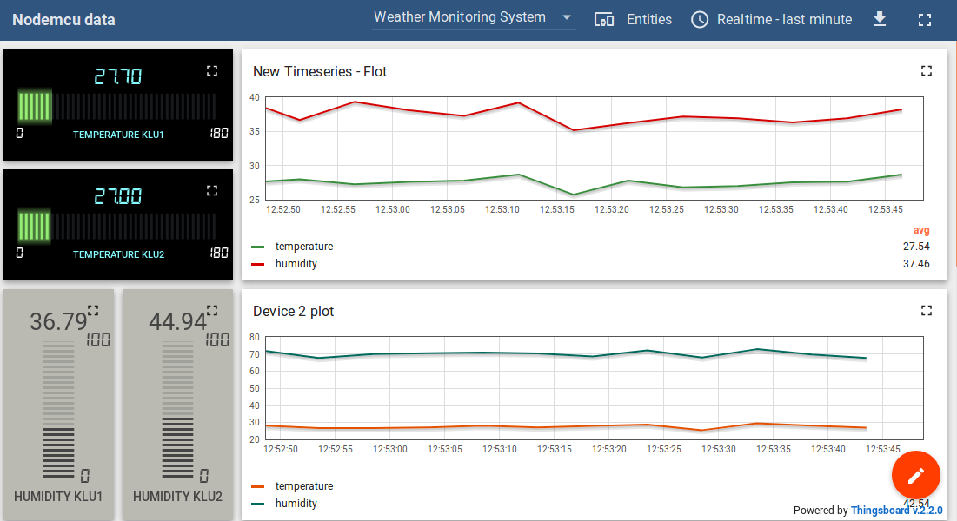
Data Visualization

Slide 21
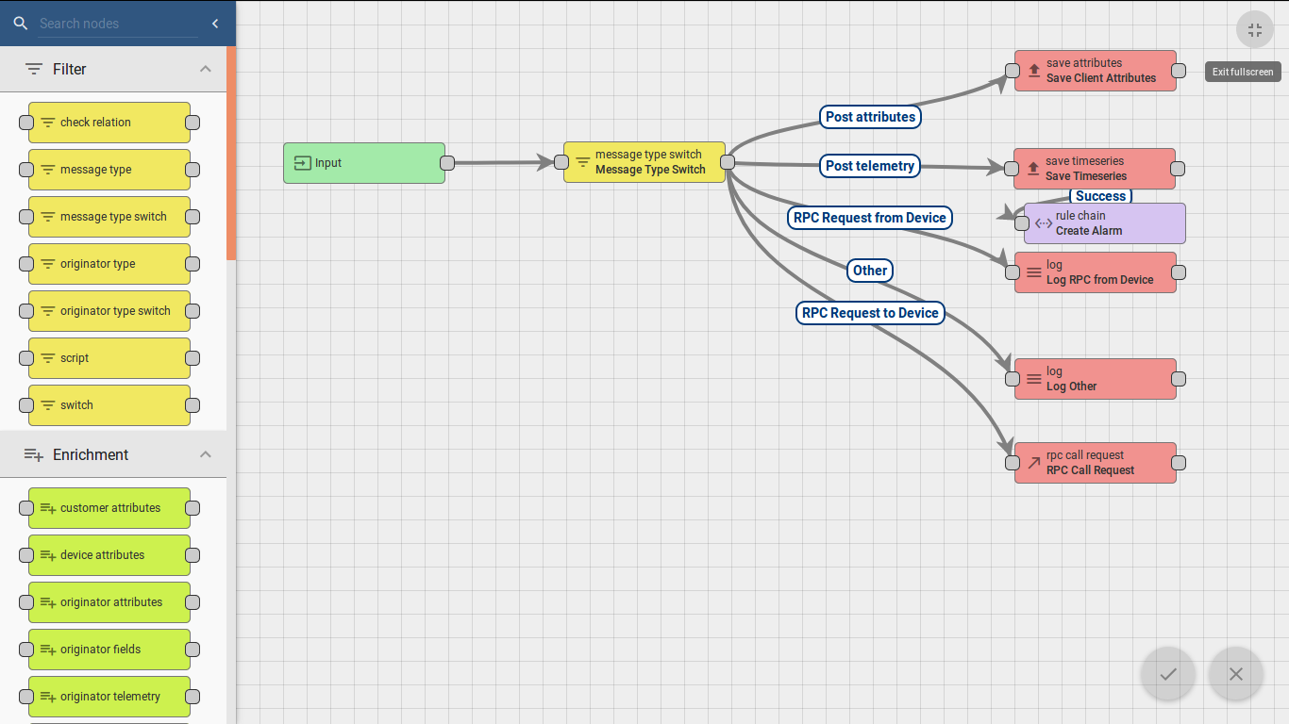
Rule Chains

Slide 22
Collecting Data and Further Steps
Collect data from Weather Monitoring Station
Data Optimization
Seperation of Data into training and testing datasets
Applying Machine learning Models
Prediction of future data

Slide 23
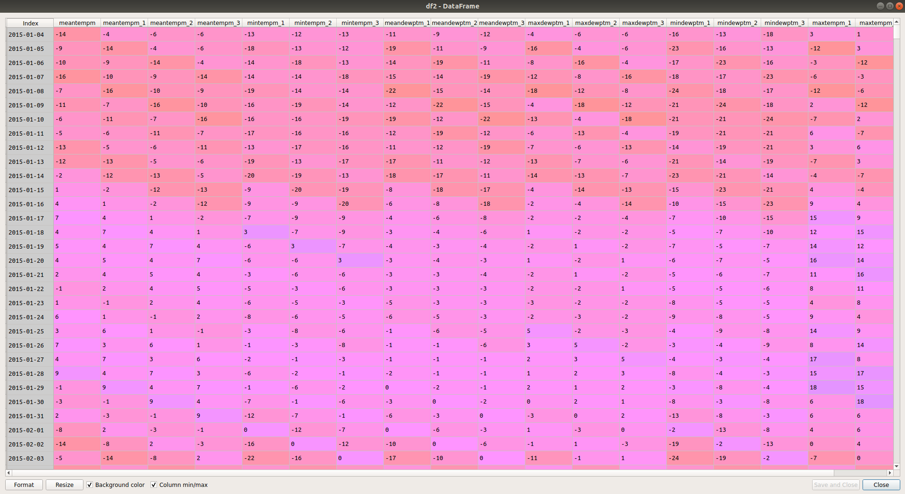
Sample Dataset

Slide 24
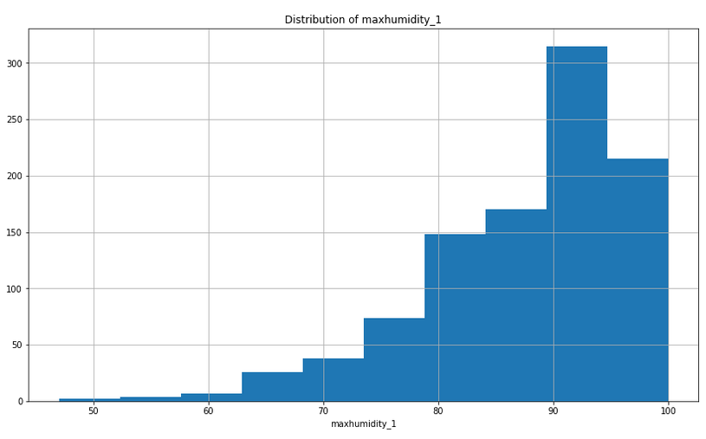
Visualization of each attribute from test data

Slide 25
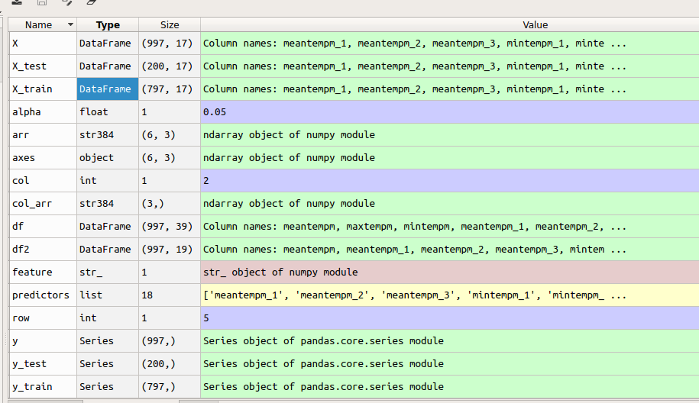
Training and testing datasets
X_train, X_test, y_train, y_test = train_test_split(X, y, test_size=0.2, random_state=12)

Slide 26
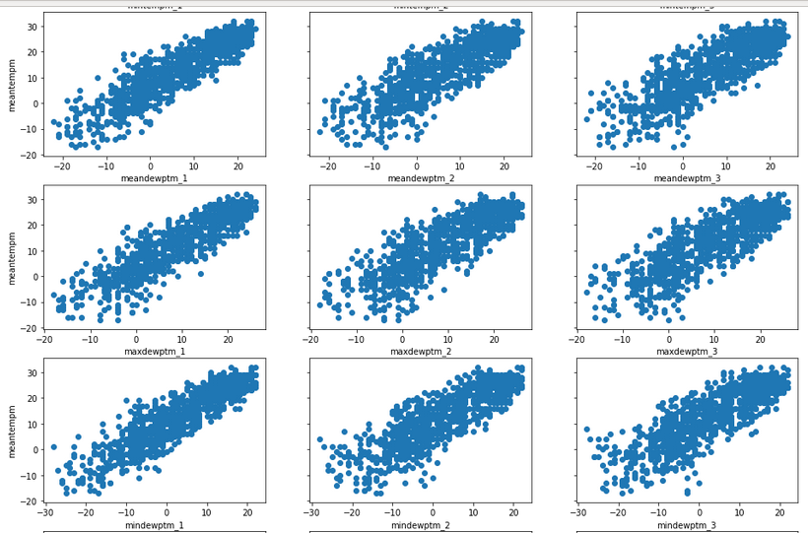
Visualization of relationships

Slide 27
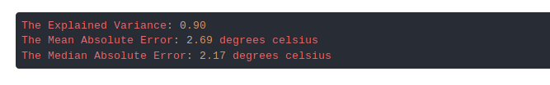
Final Output
model = sm.OLS(y, X).fit()
print("The Explained Variance: %.2f" % regressor.score(X_test, y_test))
print("The Mean Absolute Error: %.2f degrees celsius" % mean_absolute_error(y_test, prediction))
print("The Median Absolute Error: %.2f degrees celsius" % median_absolute_error(y_test, prediction))

Slide 28
Future Scope
This will conclude that the real time data successfully helpful because there is difficulty in prediction of future weather. Furthermore, we can implement this project to work by using the live data from the harware device located in various weather stations. By using better regression predicting algorithms to improve more accuracy which leads better model.

Slide 29
References
https://thingsboard.io/docs/samples/nodemcu/temperature/
http://nodemcu.com/index_en.html
https://thingsboard.io/docs/user-guide/visualization/
https://iotbytes.wordpress.com/store-mqtt-data-from-sensors-into-sql-database/
https://www.survivingwithandroid.com/2016/10/mqtt-protocol-tutorial.html
https://stackabuse.com/using-machine-learning-to-predict-the-weather-part-1/
https://stackabuse.com/using-machine-learning-to-predict-the-weather-part-2/
https://stackabuse.com/using-machine-learning-to-predict-the-weather-part-3/

Slide 30

Q & A

Slide 31


